Slide 1
Excel API Performance Tool
Amy Wang

Slide 2
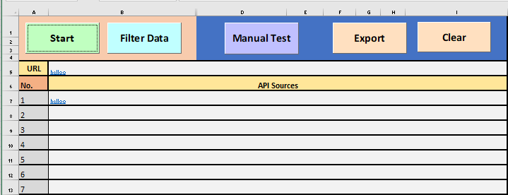
Main Sheet
Data Sheet

Slide 3
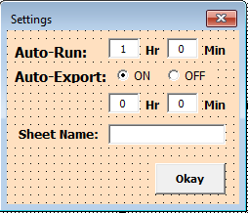

Slide 4
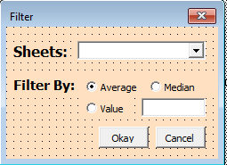

Slide 5
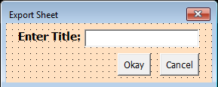

Slide 6
Data Sheet

